Slide 1

DAO
Plain Old Java Objects
C.R.U.D.
Organizing Code
Multiple Implementations

Slide 2

See Also
http://www.informit.com/guides/content.aspx?g=java&seqNum=137
http://www.tutorialspoint.com/design_pattern/data_access_object_pattern.htm
Notes:
Some additional information on concurrency

Slide 3
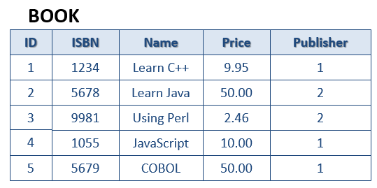
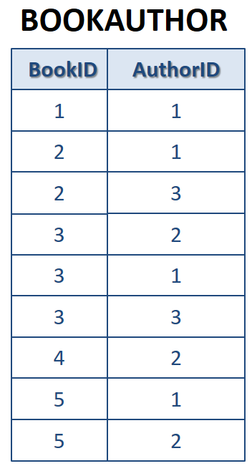
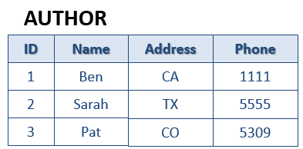
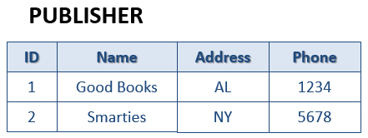
Plain Old Java Object (POJO)
public class Book {
public String getName() ...
public void setName(String name) ...
public Publisher getPublisher() ...
public void setPublisher(Publisher pub) ...
public List<Author> getAuthors() ...
public void setAuthor(List<Author> authors) ...
// ID
// ISBN
// PRICE
}
public class Author {
// ID
// NAME
// ADDRESS
// PHONE
}
public class Publisher {
// ID
// NAME
// ADDRESS
// PHONE
}
Streams of bytes … two ways (into your program and out of your program)
Disks, consoles, sockets, keyboards, printers
Know how to talk streams and you can talk to anything
Initialization (constructor) is different. Use is the same.

Slide 4
For Example
-- connect 'jdbc:derby://localhost/books;create=true'
drop table app.bookauthors;
drop table app.books;
drop table app.publishers;
drop table app.authors;
create table app.PUBLISHERS (
id INT PRIMARY KEY GENERATED ALWAYS AS IDENTITY,
name varchar(20) not null,
address varchar(20) not null,
phone varchar(20) not null
);
insert into app.PUBLISHERS (name,address,phone) values ('Good Books','AL','1234');
insert into app.PUBLISHERS (name,address,phone) values ('Smarties','NY','5678');
create table app.AUTHORS (
id INT PRIMARY KEY GENERATED ALWAYS AS IDENTITY,
name varchar(20) not null,
address varchar(20) not null,
phone varchar(20) not null
);
insert into app.AUTHORS (name,address,phone) values ('Ben','CA','1111');
insert into app.AUTHORS (name,address,phone) values ('Sarah','TX','5555');
insert into app.AUTHORS (name,address,phone) values ('Pat','CO','5309');
create table app.BOOKS (
id INT PRIMARY KEY GENERATED ALWAYS AS IDENTITY,
isbn varchar(20) not null,
name varchar(20) not null,
price double not null check(price>=0.0),
publisher int not null REFERENCES APP.PUBLISHERS(id)
);
insert into app.BOOKS (isbn,name,price,publisher) values ('1234','Learn C++',9.95,1);
insert into app.BOOKS (isbn,name,price,publisher) values ('5678','Learn Java',50.0,2);
insert into app.BOOKS (isbn,name,price,publisher) values ('9981','Using Perl',2.46,2);
insert into app.BOOKS (isbn,name,price,publisher) values ('1055','JavaScript',10.00,1);
insert into app.BOOKS (isbn,name,price,publisher) values ('5679','COBOL',50.00,1);
create table app.BOOKAUTHORS (
bookid int not null REFERENCES APP.BOOKS(id),
authorid int not null REFERENCES APP.AUTHORS(id)
);
insert into app.BOOKAUTHORS (bookid,authorid) values (1,1);
insert into app.BOOKAUTHORS (bookid,authorid) values (2,1);
insert into app.BOOKAUTHORS (bookid,authorid) values (2,3);
insert into app.BOOKAUTHORS (bookid,authorid) values (3,2);
insert into app.BOOKAUTHORS (bookid,authorid) values (3,1);
insert into app.BOOKAUTHORS (bookid,authorid) values (3,3);
insert into app.BOOKAUTHORS (bookid,authorid) values (4,2);
insert into app.BOOKAUTHORS (bookid,authorid) values (5,1);
insert into app.BOOKAUTHORS (bookid,authorid) values (5,2);
Books.sql
Streams of bytes … two ways (into your program and out of your program)
Disks, consoles, sockets, keyboards, printers
Know how to talk streams and you can talk to anything
Initialization (constructor) is different. Use is the same.

Slide 5
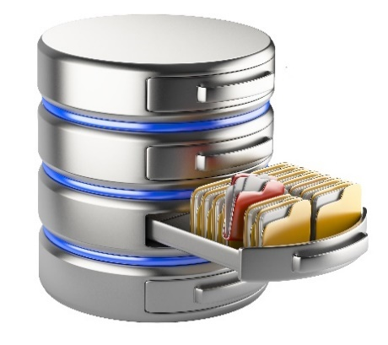
C R U D
Author a = DBDAO.createAuthor("Chris","My Street","123-4567");
a.setPhone("123-4444");
DBDAO.update(a);
a = DBDAO.getAuthor("Joe");
List<Author> as = DBDAO.getAuthors("Joe");
as = DBDAO.getAllAuthors();
DBDAO.delete(a);
Create
Update
DBDAO
Read
Delete
Streams of bytes … two ways (into your program and out of your program)
Disks, consoles, sockets, keyboards, printers
Know how to talk streams and you can talk to anything
Initialization (constructor) is different. Use is the same.

Slide 6

Data Access Objects
AuthorDAO
Author a = AuthorDAO.create("Chris");
a.setPhone("123-4444");
AuthorDAO.update(a);
Publisher p = PublisherDAO.get("Techin");
List<Book> bs = BookDAO.getAll();
BookDAO.delete(bs.get(0));
PublisherDAO
BookDAO
Streams of bytes … two ways (into your program and out of your program)
Disks, consoles, sockets, keyboards, printers
Know how to talk streams and you can talk to anything
Initialization (constructor) is different. Use is the same.

Slide 7
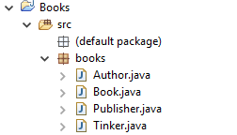
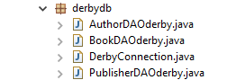
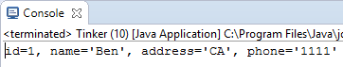
Organizing the Code
package books;
import derbydb.AuthorDAOderby;
public class Tinker {
public static void main(String[] args) {
Author a = AuthorDAOderby.getByID(1);
System.out.println(a);
}
}

Slide 8
Multiple DAO Implementations
public class AuthorDAOderby {
public static Author getByID(int id) throws SQLException {
try(Connection conn = DerbyConnection.getConnection()) {
String sql = "select * from app.authors where id=?";
PreparedStatement st = conn.prepareStatement(sql);
st.setInt(1, id);
ResultSet rs = st.executeQuery();
if(rs.next()) {
Author ret = new Author(id);
ret.setName(rs.getString("name"));
ret.setPhone(rs.getString("phone"));
ret.setAddress(rs.getString("address"));
return ret;
}
return null;
}
}
public class AuthorDAOmemory {
private static List<Author> authors =
new ArrayList<Author>();
public static Author getByID(int id) {
for(Author a : authors) {
if(a.getId() == id) {
return a;
}
}
return null;
}

Slide 9
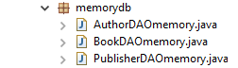
Organizing the Code
package books;
//import derbydb.AuthorDAOderby;
import memorydb.AuthorDAOmemory;
public class Tinker {
public static void main(String[] args) {
//Author a = AuthorDAOderby.getByID(1);
Author a = AuthorDAOmemory.getByID(1);
System.out.println(a);
}
}

Slide 10
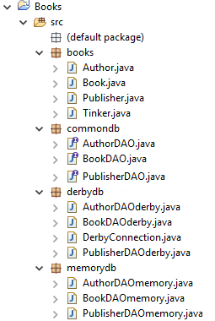
Programming to the DAO Interface
public interface AuthorDAO {
public Author create(String name, String address, String phone);
public List<Author> getAll();
public Author getByID(int id);
public void update(Author author);
public void delete(Author author);
}
public class AuthorDAOderby implements AuthorDAO {
@Override
public Author getByID(int id) throws SQLException {
try(Connection conn = DerbyConnection.getConnection()) {
...
}
}

Slide 11
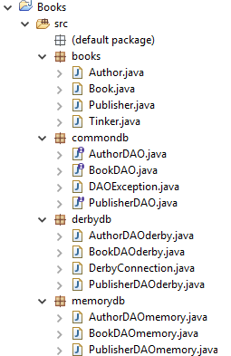
DAO Exception
public class DAOException extends Exception {
private static final long serialVersionUID = 1L;
public DAOException(Exception cause) {
super(cause);
}
}

Slide 12
Programming to the DAO Interface
public interface AuthorDAO {
public Author create(String name,
String address, String phone) throws DAOException;
public List<Author> getAll() throws DAOException;
public Author getByID(int id) throws DAOException;
public void update(Author author) throws DAOException;
public void delete(Author author) throws DAOException;
}
public class AuthorDAOderby implements AuthorDAO {
@Override
public Author getByID(int id) throws DAOException {
try(Connection conn = DerbyConnection.getConnection()) {
...
} catch (SQLException e) {
throw new DAOException(e);
}
}

Slide 13
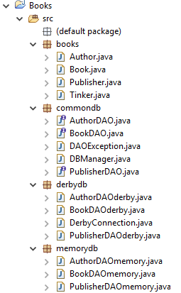
Configuring Implementations
public class DBManager {
static AuthorDAO authorDAO;
static BookDAO bookDAO;
static PublisherDAO publisherDAO;
public static void configure(int type) {
if(type==1) {
authorDAO = new AuthorDAOderby();
bookDAO = new BookDAOderby();
publisherDAO = new PublisherDAOderby();
} else {
authorDAO = new AuthorDAOmemory();
bookDAO = new BookDAOmemory();
publisherDAO = new PublisherDAOmemory();
}
}
public static AuthorDAO getAuthorDAO() {
return authorDAO;
}

Slide 14
Configuring Implementations
public class Tinker {
public static void main(String[] args) throws Exception {
DBManager.configure(1);
AuthorDAO authorDAO = DBManager.getAuthorDAO();
Author a = authorDAO.getByID(1);
System.out.println(a);
}
}

Slide 15
Final Thoughts on Databases
Simple static DAOs are fine for simple needs (like the upcoming course exercise!).
Complex designs can be wired up at runtime.
Have a look at “Dependency Injection” and the Spring framework.
There are ORM (Object-Relational Mappings) libraries like Hibernate that manage mapping objects to tables for you.
You still have to understand relational databases, and these tools have a learning curve.
There are other types of databases. You have heard the buzz words:
NoSQL
Big Data

Slide 16

Tinkering
Use the “Books.sql” file to create the sample database from this lesson. Flesh out a few of the DAO methods from this lesson.
Start with Author and Publisher.
How can your DAOs handle the books-have-multiple-authors relationship?
Notes:
Here are some things to think about … nothing to submit.
Share your thoughts in the online portal discussion area.

